Slide 1
OPERATING SYSTEM SEM III UNIT - II

Slide 2
SUGGESTED BOOKS
A. Silberschatz, P. Galvin, G. Gagne, Operating System Concepts, 10th ed., Wiley, 2018.
W. Stallings, Operating Systems: Internal and Design Principles, 9th ed., Pearson, 2018.
A. Tanenbaum, Modern Operating Systems, Pearson, 4th ed., 2015.

Slide 3
UNIT- II (PROCESS MANAGEMENT)
Process Management:
Concept of a Process, Process States, Process Description, Process Control Block,
Operations on Processes.
Threads: Definition and Types, Concept of Multithreading,
Scheduling: Types of Scheduling: Preemptive and, Non-preemptive, Scheduling
algorithms and their performance evaluation: FCFS, SJF, SRTF, Priority based,
Round Robin.

Slide 4


Program Vs process
Alvaro Morte
Professor
A program is set of instructions.
Program is passive and have longer lifespan.
Program is stored on disk and doesn’t require any resource.
A process is program in execution/action.
Process is Active and has limited lifetime.
Process holds resources such as CPU, memory address, disk, I/o etc.
Notes:
Normally he is Alvaro Morte. When he is in getup and active he becomes professor.

Slide 5
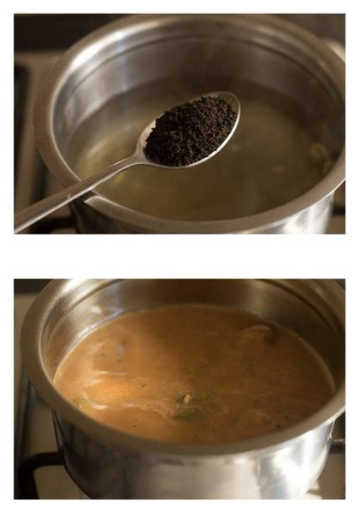
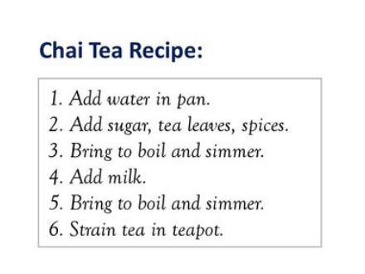
Program vs Process

Slide 6


Process
Algorithm: A part of computer program that performs a well-defined task.
Software: A collection of computer programs, libraries, and related data are referred to as a software.
A program becomes a process when an executable file is loaded into memory.
Although two processes may be associated with the same program, they are nevertheless considered two separate execution sequences.
When in memory
CPU and resources allocated
Process
Program

Slide 7
Process
An operating system executes a variety of programs:
● Batch system – jobs ( Program +I/O+ Control Inst.)
● Time-shared systems – user programs or tasks
A process includes:
● program counter
● stack
● data section
● heap
In Linux, how do you see process info and what can you see will be taken in Unix lab

Slide 8
PROCESS
In computing, a process is the instance of a computer program that is being executed by one or many threads.
It contains the program code and its activity.
Depending on the operating system (OS), a process may be made up of multiple threads of execution that execute instructions concurrently.
A program becomes a process when an executable file is loaded into memory and becomes active.
Two common techniques for loading executable files are
double-clicking an icon representing the executable file
entering the name of the executable file on the command line

Slide 9
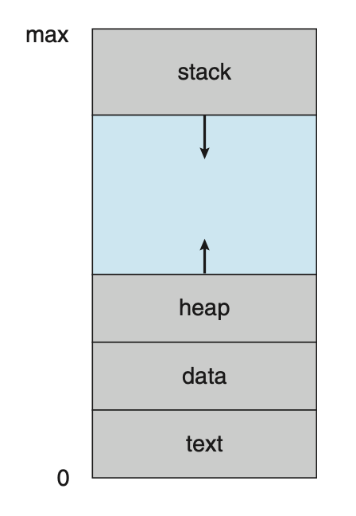
Memory Layout of Process
The status of the current activity of a process is represented by the value of the program counter and the contents of the processor’s registers.
Text Section. : the executable code It includes the current activity which is represented by value of Program counter(PC) and the contents of the processor’s register.
Data Section : global variables
Heap Section : memory that is dynamically allocated during program run time
Stack Section : temporary data storage when invoking functions (such as function parameters, return addresses, and local variables)
The sizes of the text and data sections are fixed, as their sizes do not change during program run time.
However, the stack and heap sections can shrink and grow dynamically during program execution.
Notes:
https://www.youtube.com/watch?v=PEa-hzXpSY4

Slide 10
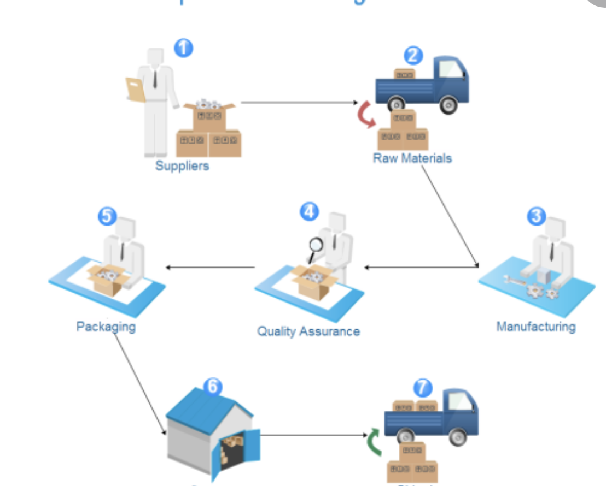
States of Process
When a process executes, it passes through different states.
State of a process defines the current activity of that process.
These stages may differ in different operating systems, and the names of these states are also not standardized.
Notes:
https://www.slideshare.net/MukeshChinta/os-process-concepts?from_action=save

Slide 11
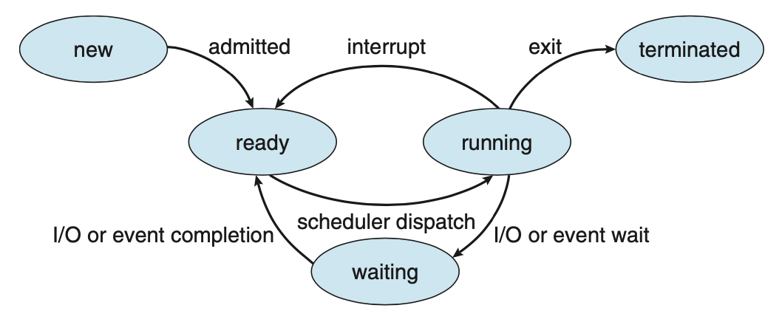
States of Process
Running time/ priority

Slide 12
States of Process
New – The process is in the stage of being created.
Ready – The process has all the resources available that it needs to run, but the CPU is not currently working on this process's instructions.
Running – The CPU is working on this process's instructions.
Waiting – The process cannot run at the moment, because it is waiting for some resource to become available or for some event to occur.
Terminated – The process has completed.

Slide 13

Process Control Block (PCB)
As the operating system supports multi-programming, it needs to keep track of all the processes.
Each process is represented in the operating system by a process control block (PCB)—also called a task control block.
It contains many pieces of information associated with a specific process.
All these information is required and must be saved when the process is switched from one state to another.

Slide 14
Process Control Block (PCB)
Information associated with each process
Process state
Program counter
CPU registers
CPU scheduling information
Memory-management information
Accounting information
I/O status information

Slide 15
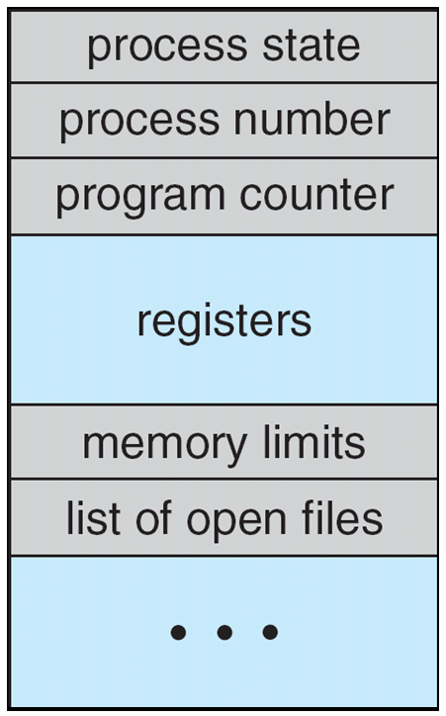
Process Control Block (PCB)
Process state: The state may be new, ready, running & so on
Program counter: It indicates the address of the next instruction to be executed for this program.
CPU registers: These vary in number and type based on architecture. They include accumulators, stack pointers, general purpose registers etc.
CPU scheduling information: This includes process priority, pointers to scheduling queues and any scheduling parameters.
Memory-management information: This includes the value of base and limit registers (protection) and page tables, segment tables depending on memory.
Accounting information: It includes amount of CPU and real time used, account numbers, process numbers etc
I/O status information: It includes list of I/O devices allocated to this process, a list of open files etc
Notes:
https://www.youtube.com/watch?v=4s2MKuVYKV8

Slide 16
Operations On Process
Operations
Process Creation
Process Termination

Slide 17
Single process execution
Process P
Processor &printer
10 min + 5min
Function 1
Print a document
5 min
printer
Function 2
Do a complex huge calculation
10 min
processor
Execution with Single process
Notes:
https://www.youtube.com/watch?v=RrTNyHGJIRU

Slide 18
Process creation
P
Printing on printer
Calculation on CPU
P1
P1
P
Total time taken to complete both the tasks = 10 min
Total time taken will be the time taken by slowest process.

Slide 19
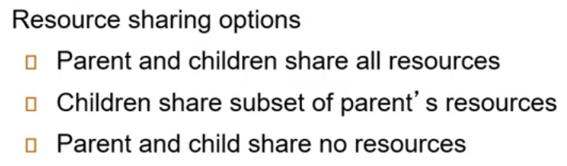
Process creation
pid process identifier
Parent – creating process
Child- new process
fork() – unix
createprocess()- Windows
OS
Subset of parents resources
Process Creation
How to create child process
How a child process gets it resources.
Notes:
https://www.youtube.com/watch?v=RrTNyHGJIRU , https://www.youtube.com/watch?v=tv3lIj5kWjM

Slide 20
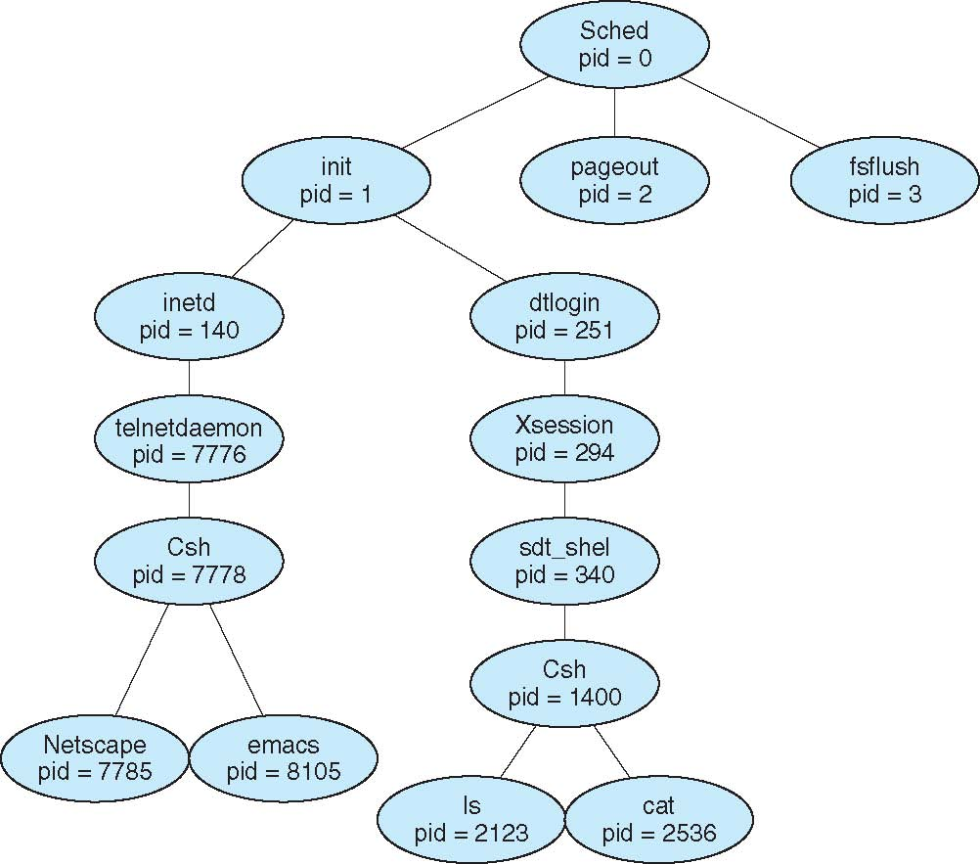
Process creation
Parent
For execution parent process can either
Continues to execute concurrently with its children. Or
Wait until some or all the children terminates.
For address-space child process
Can be a duplicate of the parent process. (it has the same program and data as the parent). Or
Has a new program loaded into it.
Child
Child process can further create process forming a tree of processes.

Slide 21

Process Termination
Process executes last statement and asks the OS to delete it with exit() system call.
Output data and status from child to parent process(via wait() system call)
Process’ resources are deallocated by operating system
Only Parent may terminate execution of children processes (abort) in following conditions:
Child has exceeded allocated resources
Task assigned to child is no longer required
If parent is exiting
Some operating system do not allow child to continue if its parent terminates
All children terminated - cascading termination
Notes:
https://www.youtube.com/watch?v=SFc3jt8t5rU

Slide 22
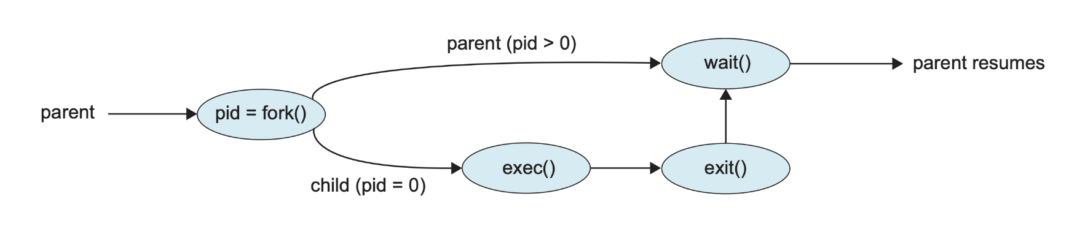
Process Creation

Slide 23

Context Switch
When CPU switches to another process, the system must save the state of the old process and load the saved state for the new process via a context switch.
Context of a process represented in the PCB
Context-switch time is overhead; the system does no useful work while switching
The more complex the OS and the PCB -> longer the context switch
Time dependent on hardware support
Some hardware provides multiple sets of registers per CPU -> multiple contexts loaded at once
PCB

Slide 24
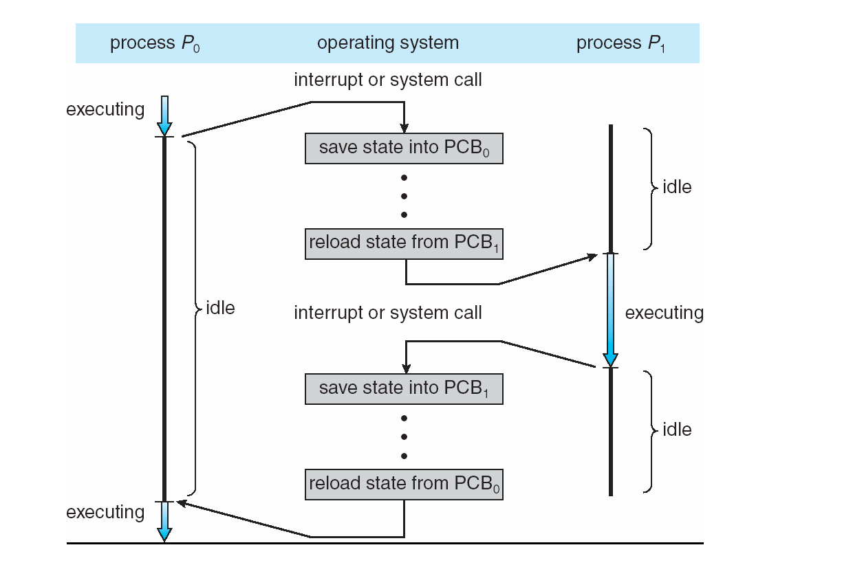
Context Switching

Slide 25


SCHEDULING

Slide 26
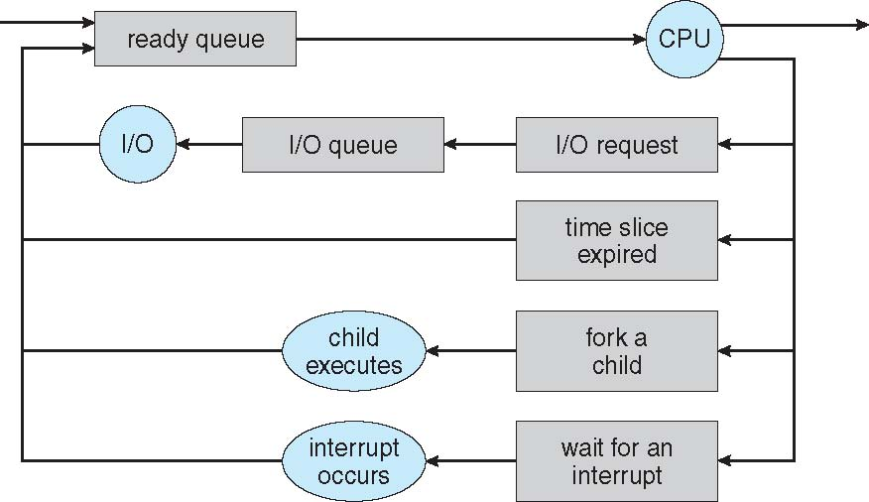
Representation of Process Scheduling

Slide 27
Schedulers
Schedulers
Long Term Scheduler
(Process Scheduler)
Short Term Scheduler (CPU scheduler)

Slide 28

Schedulers
Long-term scheduler (or job/process scheduler) –
selects which processes should be brought into the “ready queue”
Short-term scheduler (or CPU scheduler) –
selects which process should be executed next and allocates CPU
Sometimes the only scheduler in a system

Slide 29
Scheduling
P1
P2
P3
Ready Queue
P4
CPU
LTS
STS
EXIT
STS
STS
Blocked Queue

Slide 30
Scheduling
P2
P3
Ready Queue
P4
CPU
P1
LTS
STS
EXIT
STS
STS
Blocked Queue
Notes:
https://www.youtube.com/watch?v=THqcAa1bbFU

Slide 31
Scheduling
P3
Ready Queue
P4
CPU
P2
LTS
P1
STS
EXIT
STS
STS
Blocked Queue

Slide 32
Scheduling
Ready Queue
CPU
LTS
P4
P3
P2
P1
STS
EXIT
STS
STS
Blocked Queue

Slide 33
Scheduling
Ready Queue
CPU
P1
LTS
P4
P3
P2
STS
EXIT
STS
STS
Blocked Queue

Slide 34
Scheduling
Ready Queue
CPU
LTS
P4
P3
P2
STS
EXIT
STS
STS
Blocked Queue

Slide 35
Schedulers
Short-term scheduler is invoked very frequently (milliseconds) ⇒ (must be fast)
Long-term scheduler is invoked very infrequently (seconds, minutes) ⇒ (may be slow)

Slide 36
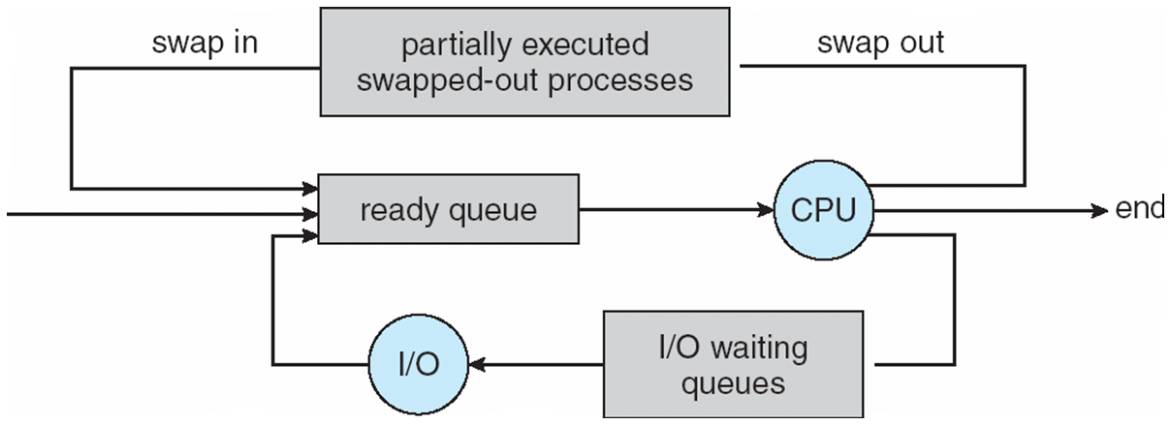
Medium Term Scheduling
Medium-term is also called swapping scheduler.
It helps you to send process back to memory.
Reduce the level of multiprogramming.
Notes:
A running process can become suspended if it makes an I/O request. A suspended processes can't make any progress towards completion. In order to remove the process from memory and make space for other https://www.guru99.com/process-scheduling.html

Slide 37


CPU Scheduling

Slide 38

CPU Scheduling
CPU scheduling is the basis of multiprogrammed OS.
Switching CPU among processes, the OS can make the computer more productive.
In single processor system only one process can run at a time.
Objective of multi programming :
To have some process running at all times , to maximize CPU utilization.

Slide 39
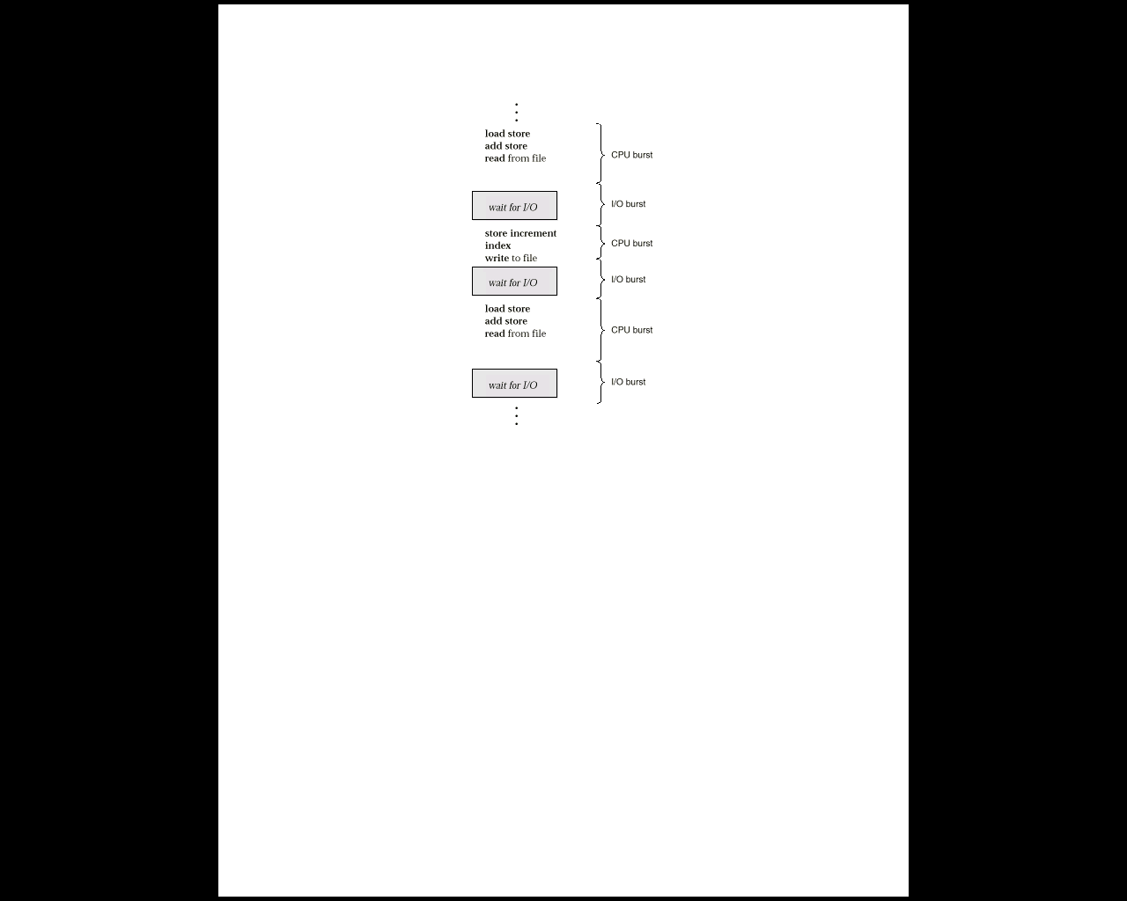
Alternating Sequence of CPU And I/O Bursts
Process execution consists of a cycle of
CPU execution and I/O wait
CPU burst is when process is being executed in the CPU
I/O burst is when CPU is waiting for I/O for further execution
Notes:
https://www.youtube.com/watch?v=pVzb3TUcDLo&list=PLBlnK6fEyqRitWSE_AyyySWfhRgyA-rHk&index=2

Slide 40
Process
Processes can be described as either:
I/O-bound process – spends more time doing I/O than computations, many short CPU bursts
CPU-bound process – spends more time doing computations; few very long CPU bursts

Slide 41
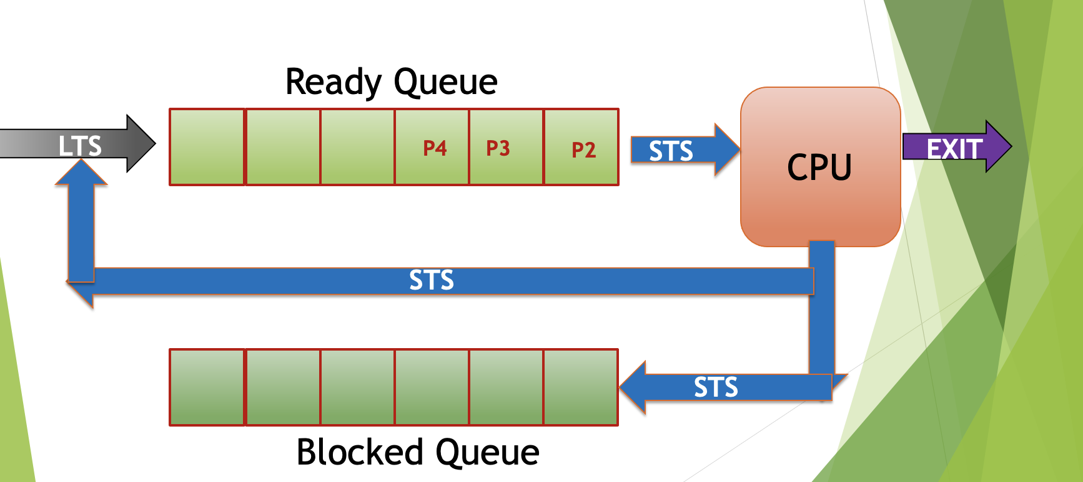
CPU scheduling
CPU Scheduler(STS) : Selects a process from the processes in the memory that are ready to execute and allocate CPU to it.
Dispatcher: Dispatcher is the module that gives control of CPU to the process selected by short-term scheduler.
MAIN OBJECTIVE
→ Maximum CPU utilization obtained with multiprogramming
→ CPU–I/O Burst Cycle – CPU burst distribution

Slide 42
CPU Scheduler
CPU scheduling decisions may take place when a process:
1. Switches from running to waiting state.
2. Switches from running to ready state.
3. Switches from waiting to ready.
4. Terminates.
Preemptive: allows a process to be interrupted in the midst of its CPU execution, taking the CPU away to another process
Non- Preemptive: the process takes the resource (CPU time) and holds it till the process gets terminated or is pushed to the waiting state.
Scheduling under 1 and 4 is non-preemptive.
All other scheduling is preemptive.

Slide 43
Dispatcher
Dispatcher module gives control of the CPU to the process selected by the short-term scheduler; this involves:
switching context
jumping to the proper location in the user program to restart that program
Dispatch latency – time it takes for the dispatcher to stop one process and start another running.

Slide 44
CPU scheduling
Arrival time :
is the time when a process enters into the ready state and is ready for its execution.
Exit time
is the time when a process completes its execution and exit from the system.
Response time
is the time spent when the process is in the ready state and gets the CPU for the first time.
Response time = Time at which the process gets the CPU for the first time - Arrival time
Notes:
https://afteracademy.com/blog/what-is-burst-arrival-exit-response-waiting-turnaround-time-and-throughput#:~:text=The%20CPU%20time%20is%20the,its%20execution%20on%20the%20CPU.

Slide 45
CPU scheduling
Waiting time
is the total time spent by the process in the ready state waiting for CPU.
Waiting time = Turnaround time - Burst time
Burst time
total time taken by the process for its execution on the CPU.
Turnaround time
is the total amount of time spent by the process from coming in the ready state for the first time to its completion.
Turnaround time = Burst time + Waiting time or Turnaround time = Exit time - Arrival time
Throughput
is a way to find the efficiency of a CPU.
It can be defined as the number of processes executed by the CPU in a given amount of time.

Slide 46
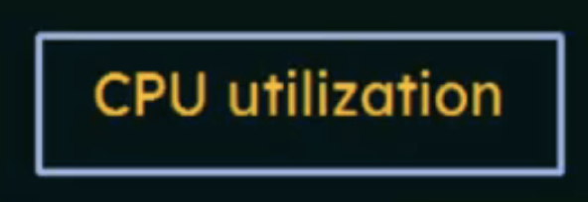

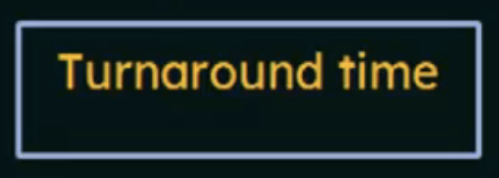

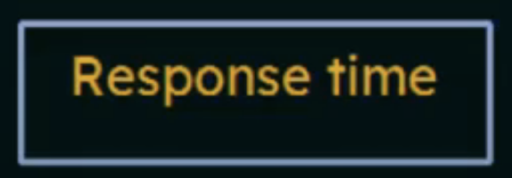
Scheduling Criteria
Max CPU utilization
Max throughput
Min turnaround time
Min waiting time
Min response time
Notes:
https://www.youtube.com/watch?v=bWHFY8-rL5I&list=PLBlnK6fEyqRitWSE_AyyySWfhRgyA-rHk&index=4

Slide 47
The CPU time is the time taken by CPU to execute the process.
While the I/O time is the time taken by the process to perform some I/O operation.
In general, we ignore the I/O time and we consider only the CPU time for a process.
So,
Burst time = total time taken by the process for its execution on the CPU.

Slide 48
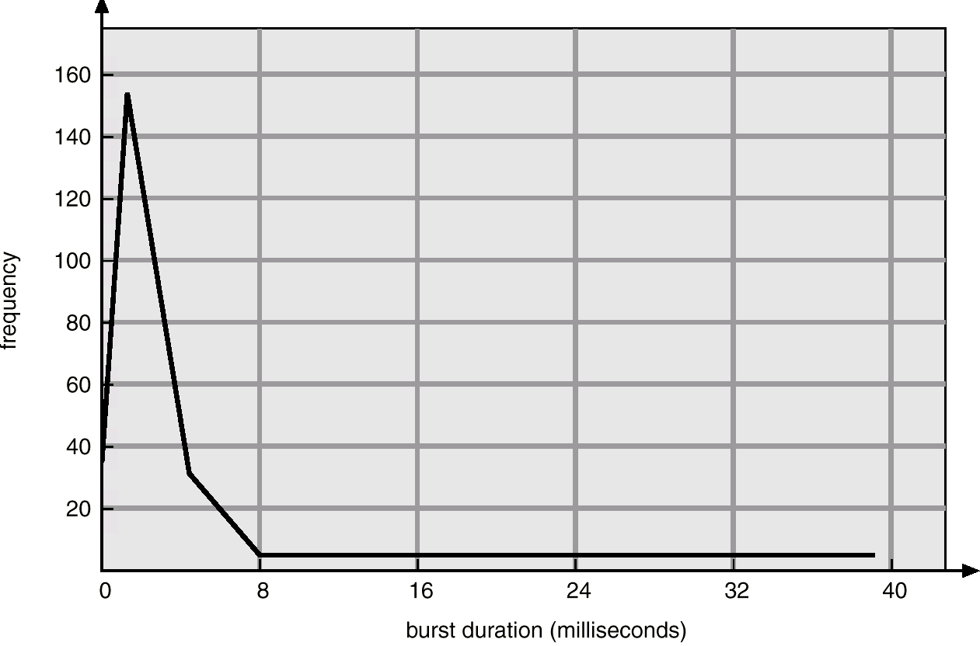
Histogram of CPU-burst Times

Slide 49
Scheduling Criteria
CPU utilization – keep the CPU as busy as possible
Throughput – # of processes that complete their execution per time unit
Turnaround time – amount of time to execute a particular process (finishing time – arrival time)
Waiting time – amount of time a process has been waiting in the ready queue
Response time – amount of time it takes from when a request was submitted until the first response is produced, not output (for time-sharing environment)

Slide 50
CPU Scheduling Algorithms

Slide 51
First-Come, First-Served (FCFS) Scheduling Non-preemptive
Process Burst Time
P₁ 24
P₂ 3
P₃ 3
Suppose that the processes arrive in the order: P₁ , P₂ , P₃ The Gantt Chart for the schedule is:
Waiting time for P₁ = 0;
P₂ = 24; P₃ = 27
Average waiting time: (0 + 24 + 27)/3 = 17
P₁
P₂
P₃
0
24
27
30

Slide 52
FCFS Scheduling (Cont.)
Suppose that the processes arrive in the order
P₂ , P₃ , P₁ .
The Gantt chart for the schedule is:
Waiting time for P₁ = 6;
P₂ = 0; P₃ = 3
Average waiting time: (6 + 0 + 3)/3 = 3
Much better than previous case. With shortest process first
P₂
P₃
P₁
0
3
6
30

Slide 53
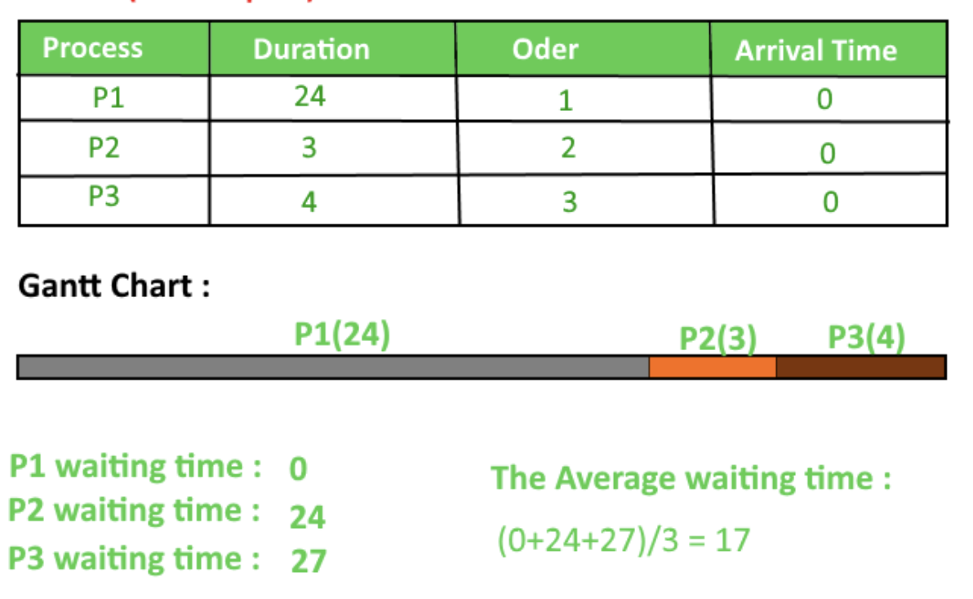
FCFS
GANTT CHART
24
27
31

Slide 54

FCFS
Process | Arrival Time | Burst Time(BT)
P1 | 2 | 2
P2 | 0 | 1
P3 | 2 | 3
P4 | 3 | 5
P5 | 4 | 4
Completion time
4
1
7
12
16
Turn Around time (CT-AT)
2
1
5
9
12
Waiting Time (TAT-BT)
0
0
2
4
8
Response Time
0
0
2
4
8
P2
P1
P3
P4
P5
0 1 2 3 4 5 6 7 8 9 10 11 12 13 14 15 16
Notes:
https://www.youtube.com/watch?v=WYo1SpUh9FI

Slide 55
FCFS
Process | Arrival Time | Burst Time(BT)
P1 | 2 | 2
P2 | 0 | 1
P3 | 2 | 3
P4 | 3 | 5
P5 | 4 | 4
Completion time
4
1
7
12
16
Turn Around time (CT-AT)
2
1
5
9
12
Waiting Time (TAT-BT)
0
0
2
4
8
Response Time
0
0
2
4
8
P2
P1
P3
P4
P5
0 1 2 3 4 5 6 7 8 9 10 11 12 13 14 15 16
Response time = Waiting time (non preemptive)
Notes:
https://www.youtube.com/watch?v=WYo1SpUh9FI

Slide 56
Shortest-Job-First (SJF) Scheduling
Associate with each process the length of its CPU burst.
Use these lengths to schedule the process with the shortest time.
Two schemes:
Non-preemptive – once CPU given to the process it cannot be preempted until completes its CPU burst.
Preemptive – if a new process arrives with CPU burst length less than remaining time of current executing process, preempt. This scheme is know as the Shortest-Remaining-Time-First (SRTF).
SJF is optimal – gives minimum average waiting time for a given set of processes.

Slide 57
Example of Non-Preemptive SJF
Process Arrival Time Burst Time
P₁ 0.0 7
P₂ 2.0 4
P₃ 4.0 1
P₄ 5.0 4
SJF (non-preemptive)
P₁
P₃
P₂
P₄
0
3
7
8
12
16

Slide 58
Example of Non-Preemptive SJF
Process Arrival Time Burst Time
P₁ 0.0 7
P₂ 2.0 4
P₃ 4.0 1
P₄ 5.0 4
SJF (non-preemptive)
Average waiting time = (0 + 6 + 3 + 7)/4
P₁
P₃
P₂
P₄
0
3
7
8
12
16

Slide 59
Example of Preemptive SJF
Process Arrival Time Burst Time
P₁ 0.0 7
P₂ 2.0 4
P₃ 4.0 1
P₄ 5.0 4
SJF (preemptive)

Slide 60
Example of Preemptive SJF
Process Arrival Time Burst Time
P₁ 0.0 7
P₂ 2.0 4
P₃ 4.0 1
P₄ 5.0 4
SJF (preemptive)
Average waiting time = (9 + 1 + 0 +2)/4 = 3
P₁
P₂
P₃
P₂
P₄
P₁
0
2
4
5
7
11
16

Slide 61

Round Robin (RR)
Each process gets a small unit of CPU time (time quantum), usually 10-100 milliseconds.
After this time has elapsed, the process is preempted and added to the end of the ready queue.
If there are n processes in the ready queue and the time quantum is q, then each process gets 1/n of the CPU time in chunks of at most q time units at once. No process waits more than (n-1)q time units.
Performance
q large ⇒ FIFO
q small ⇒ q must be large with respect to context switch, otherwise overhead is too high.
n | q
5 | 10

Slide 62
Example of RR with Time Quantum = 20
Process Burst Time
P₁ 53
P₂ 17
P₃ 68
P₄ 24
The Gantt chart is:
Typically, higher average turnaround than SJF, but better response.
P₁
P₂
P₃
P₄
P₁
P₃
P₄
P₁
P₃
P₃
0
20
37
57
77
97
117
121
134
154
162

Slide 63
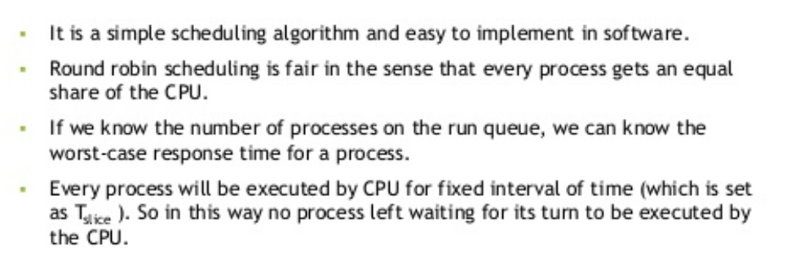
Advantage of RR

Slide 64
Priority Scheduling
A priority number (integer) is associated with each process
The CPU is allocated to the process with the highest priority ( smallest integer ≡ highest priority).
Preemptive
nonpreemptive
SJF is a priority scheduling where priority is the predicted next CPU burst time.
Problem ≡ Starvation – low priority processes may never execute.
Solution ≡ Aging – as time progresses increase the priority of the process.

Slide 65
THREADS

Slide 66
Thread Overview
Threads are mechanisms that permit an application to perform multiple tasks concurrently.
Thread is a basic unit of CPU utilization
Thread ID
Program counter
Register set
Stack
A single program can contain multiple threads
Threads share with other threads belonging to the same process
Code, data, open files…….

Slide 67
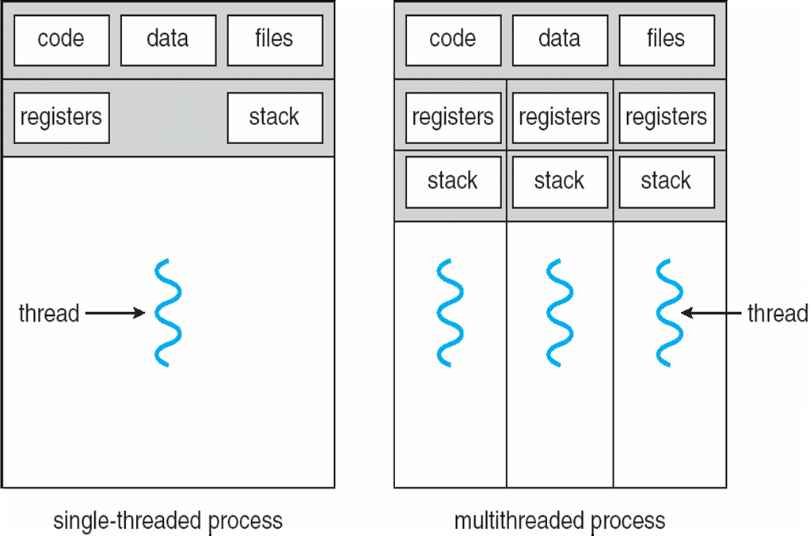
Single and Multithreaded Processes
heavyweight process
lightweight process
Traditional (heavyweight) process has a single thread of control

Slide 68
Threads in Memory
Memory is allocated for a process in segments or parts:
Process Memory
Stack for main thread
Stack for thread 1
Increasing virtual address
Stack for thread 2
Stack for thread 3
Heap
Un-initialized data
Initialized data
Text ( program code)
Thread 1 executing here
Main thread executing here
Thread 3 executing here
Thread 2 executing here
0000000
Notes:
Text: Made read-only so you don’t accidently modify your own instructions. Since many processes may be running the same program, this may be shared.
uninitialized data may be set to 000’s

Slide 69
Threads
Threads specific
Attributes….
Threads share….
Global memory
Process ID and parent process ID
Controlling terminal
Process credentials (user )
Open file information
Timers
………
Thread ID
Thread specific data
CPU affinity
Stack (local variables and function call linkage information)
……

Slide 70
Benefits
Responsiveness Interactive application can delegate background functions to a thread and keep running
Resource Sharing Several different threads can access the same address space
Economy Allocating memory and new processes is costly. Threads are much ‘cheaper’ to initiate.
Scalability
Use threads to take advantage of multiprocessor architecture

Slide 71
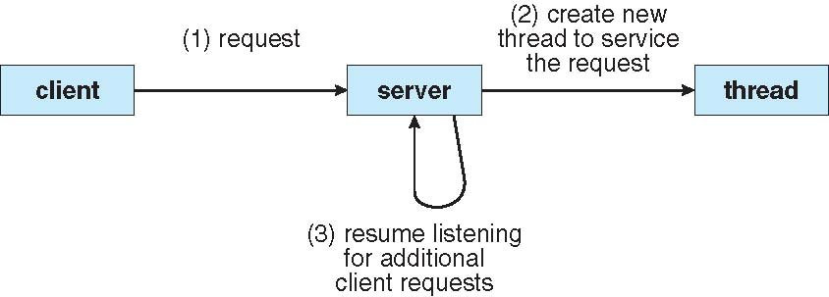
Multithreaded Server Architecture
thread
thread
thread
thread

Slide 72
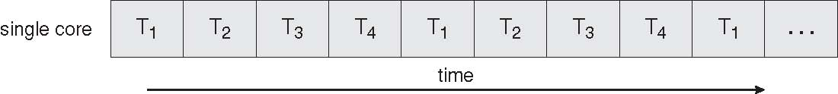
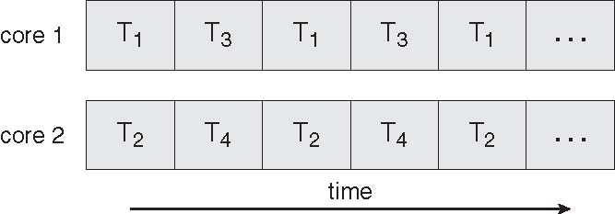
Concurrent Execution on a Single-core System
Multicore Programming
Parallel Execution on a Multicore System

Slide 73
Threads Assist Multicore Programming
thread
thread
thread
Let threads on different CPUs
thread

Slide 74
Multithreading Models
Support provided at either
User level -> user threads
Supported above the kernel and managed without kernel support
Kernel level -> kernel threads
Supported and managed directly by the operating system

Slide 75
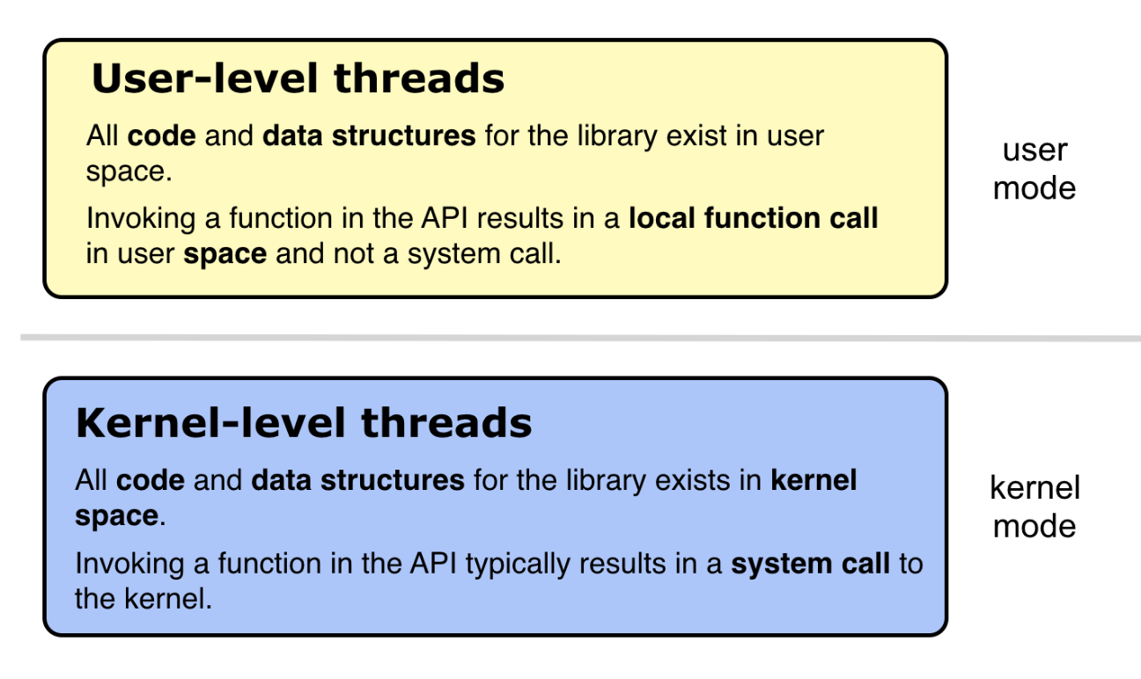
Multithreading Models
Support provided at either
User level -> user threads
Supported above the kernel and managed without kernel support
Kernel level -> kernel threads
Supported and managed directly by the operating system
What is the relationship between user and kernel threads?

Slide 76
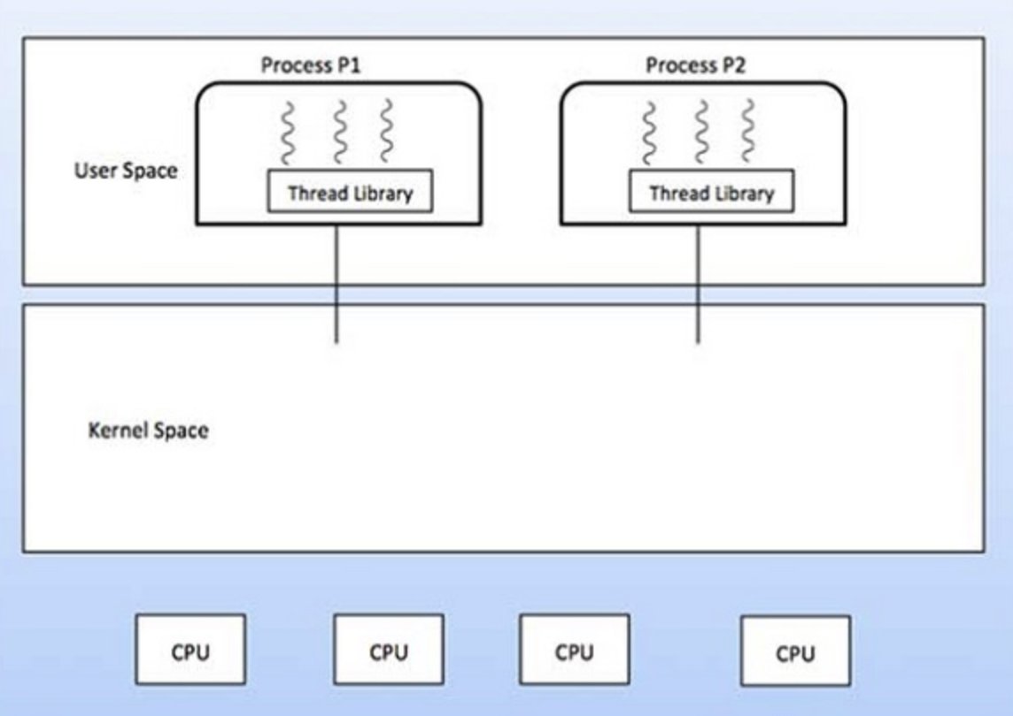
User Threads
Thread management done by user-level threads library
Three primary thread libraries:
POSIX Pthreads
Win32 threads
Java threads
Thread switching does not need to call OS and to cause interrupt to Kernel.
Kernel doesn’t know about the user level thread and manages them as if
they were single-threaded processes.

Slide 77
Kernel Threads
Supported by the Kernel
Kernel-level threads are slower than user-level threads
Kernel threads are supported directly by the operating system.

Slide 78
Multithreading Models
User Thread – to - Kernel Thread
Many-to-One
One-to-One
Many-to-Many

Slide 79
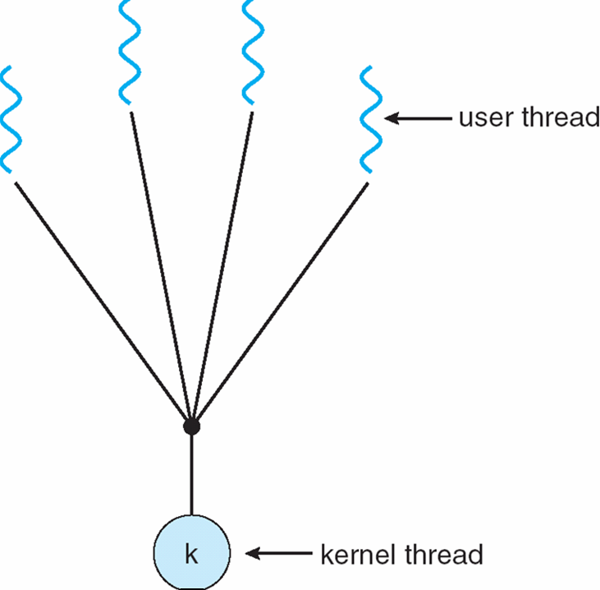
Many-to-One
Many user-level threads mapped to single kernel thread

Slide 80
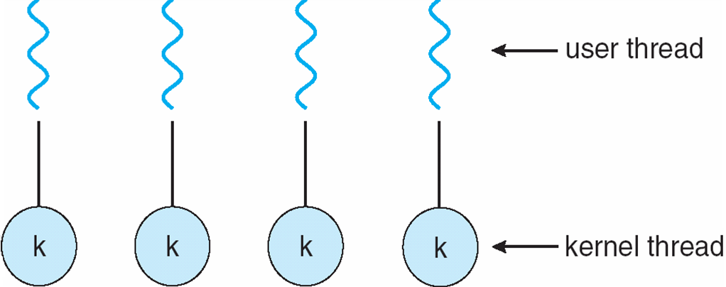
One-to-One
Each user-level thread maps to kernel thread
Examples
Windows NT/XP/2000
Linux
Notes:
Examples
Windows NT/XP/2000
Linux

Slide 81
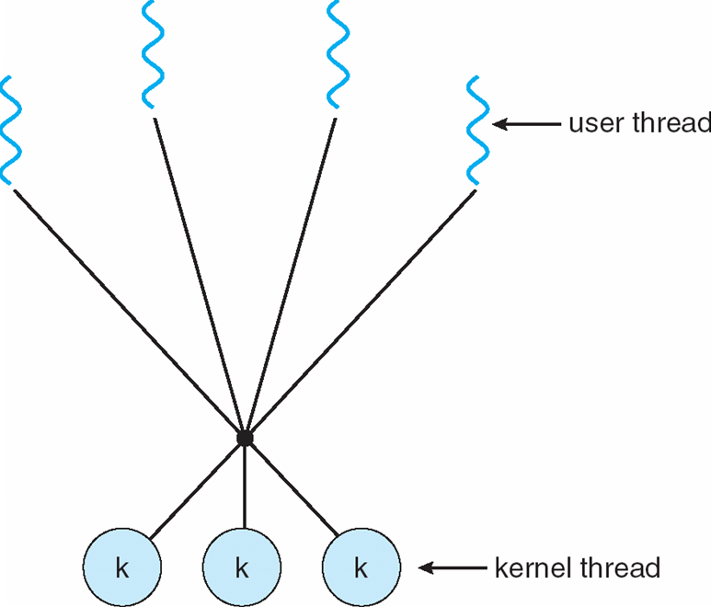
Many-to-Many Model
Allows many user level threads to be mapped to many kernel threads
Allows the operating system to create a sufficient number of kernel threads
Example
Windows NT/2000 with the ThreadFiber package

Slide 82
END of UNIT-II

Slide 83
Determining Length of Next CPU Burst
Can only estimate the length.
Can be done by using the length of previous CPU bursts, using exponential averaging.

Slide 84
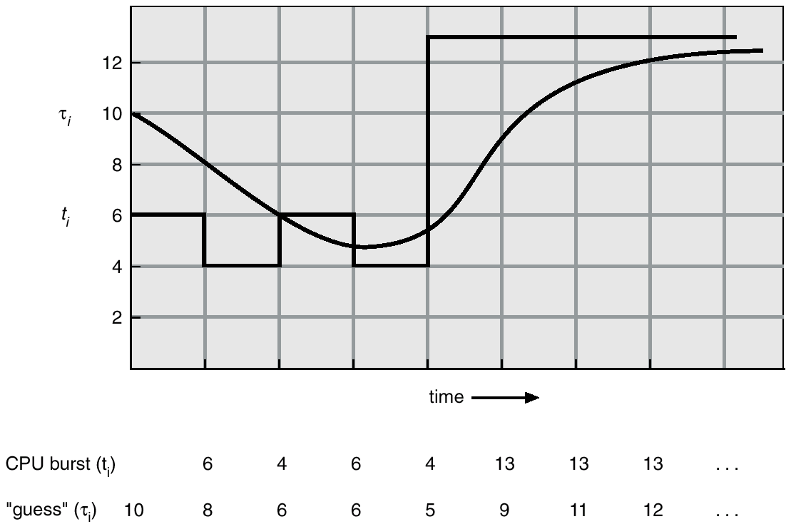
Prediction of the Length of the Next CPU Burst

Slide 85
Examples of Exponential Averaging
α =0
τ_{n+1} = τ_{n}
Recent history does not count.
α =1
τ_{n+1} = t_{n}
Only the actual last CPU burst counts.
If we expand the formula, we get:
τ_{n+1} = α t_{n}+(1 - α) α t_{n} -1 + …
+(1 - α )^{j} α t_{n} -1 + …
+(1 - α )^{n=1} t_{n} τ₀
Since both α and (1 - α) are less than or equal to 1, each successive term has less weight than its predecessor.

Slide 86
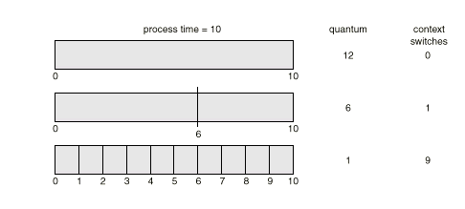
Time Quantum and Context Switch Time

Slide 87
Scheduling Criteria
CPU utilization – keep the CPU as busy as possible
Throughput – # of processes that complete their execution per time unit
Turnaround time – amount of time to execute a particular process (finishing time – arrival time)
Waiting time – amount of time a process has been waiting in the ready queue
Response time – amount of time it takes from when a request was submitted until the first response is produced, not output (for time-sharing environment)

Slide 88
Class Exercise
Each team works on finding an average turnaround time for a
quantum time at 1, 2, 3, 4, 5, 6, 7
Process | Time
p1 | 6
P2 | 3
P3 | 7
p4 | 1

Slide 89
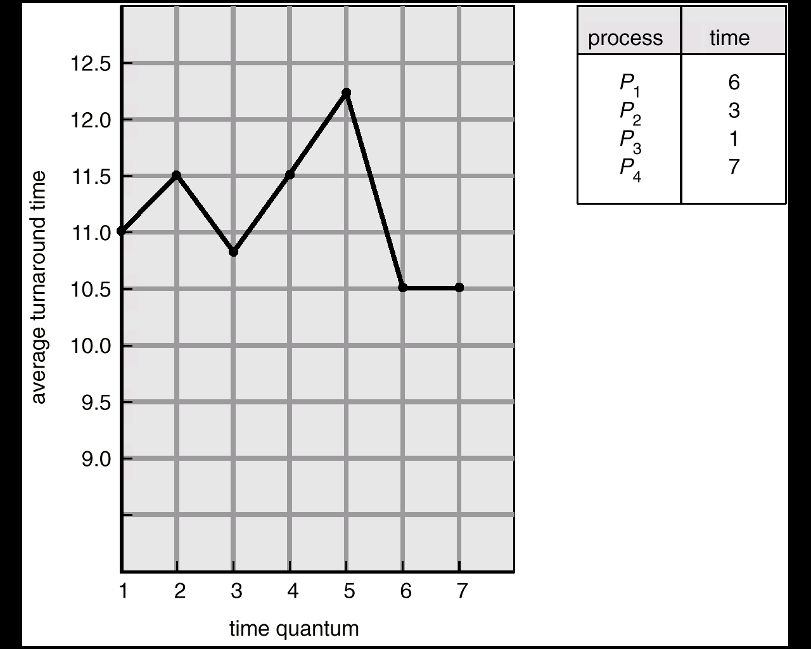
Turnaround Time Varies With The Time Quantum

Slide 90
Multilevel Queue
Ready queue is partitioned into separate queues: foreground (interactive) background (batch)
Each queue has its own scheduling algorithm, foreground – RR background – FCFS
Scheduling must be done between the queues.
Fixed priority scheduling; (i.e., serve all from foreground then from background). Possibility of starvation.
Time slice – each queue gets a certain amount of CPU time which it can schedule amongst its processes; i.e., 80% to foreground in RR
20% to background in FCFS

Slide 91
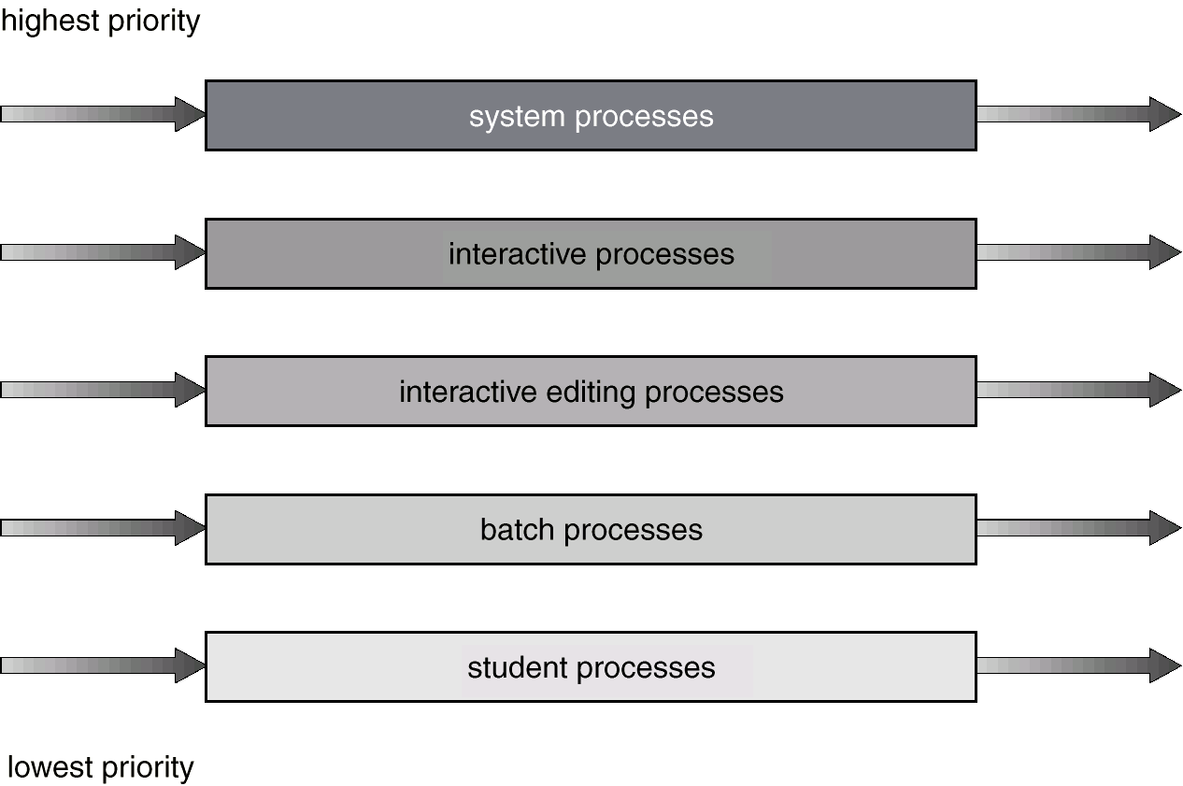
Multilevel Queue Scheduling

Slide 92
Multilevel Feedback Queue
A process can move between the various queues; aging can be implemented this way.
Multilevel-feedback-queue scheduler defined by the following parameters:
number of queues
scheduling algorithms for each queue
method used to determine when to upgrade a process
method used to determine when to demote a process
method used to determine which queue a process will enter when that process needs service

Slide 93
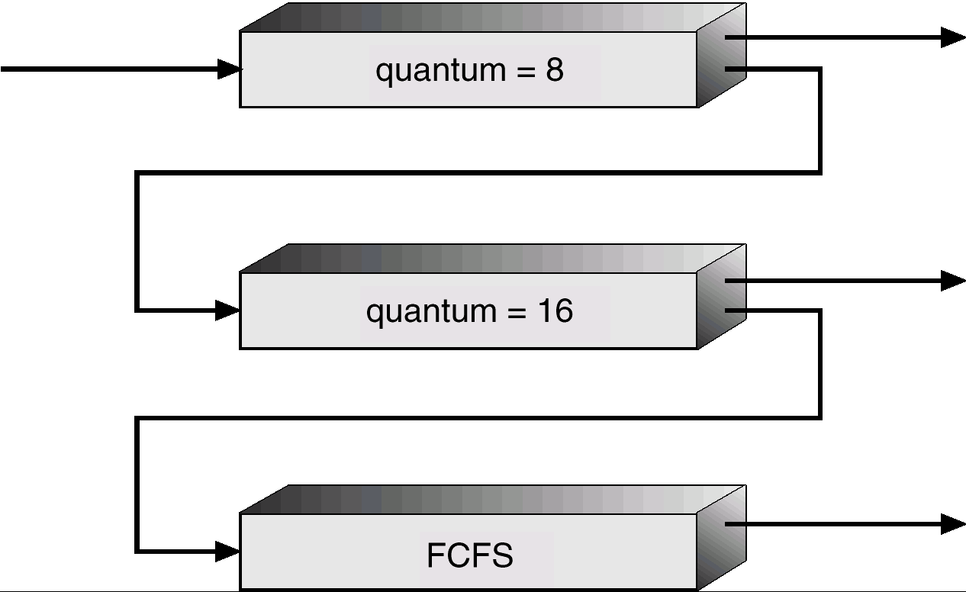
Multilevel Feedback Queues

Slide 94
Example of Multilevel Feedback Queue
Three queues:
Q₀ – time quantum 8 milliseconds
Q₁ – time quantum 16 milliseconds
Q₂ – FCFS
Scheduling
A new job enters queue Q₀ which is served FCFS. When it gains CPU, job receives 8 milliseconds. If it does not finish in 8 milliseconds, job is moved to queue Q₁.
At Q₁ job is again served FCFS and receives 16 additional milliseconds. If it still does not complete, it is preempted and moved to queue Q₂.

Slide 95
Multiple-Processor Scheduling
CPU scheduling more complex when multiple CPUs are available.
Homogeneous processors within a multiprocessor.
Load sharing
Asymmetric multiprocessing – only one processor accesses the system data structures, alleviating the need for data sharing.

Slide 96
Real-Time Scheduling
Hard real-time systems – required to complete a critical task within a guaranteed amount of time.
Soft real-time computing – requires that critical processes receive priority over less fortunate ones.

Slide 97
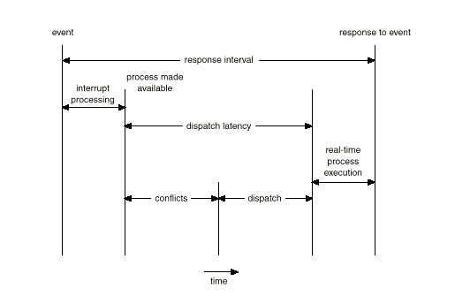
Dispatch Latency

Slide 98
Algorithm Evaluation
Deterministic modeling – takes a particular predetermined workload and defines the performance of each algorithm for that workload.
Queueing models
Implementation

Slide 99
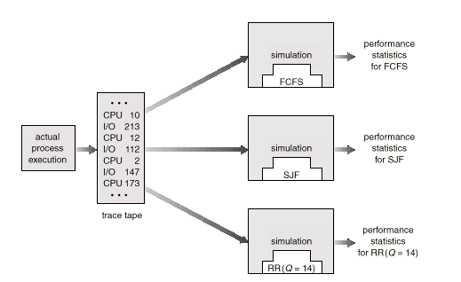
Evaluation of CPU Schedulers by Simulation

Slide 100
Process Scheduling Models
Linux Process Scheduling
2 separate process-scheduling algorithms
time-sharing: a prioritized credit-based
Soft-real time: FCFS and RR
only allows processes in a user mode to be preempted.

Slide 101
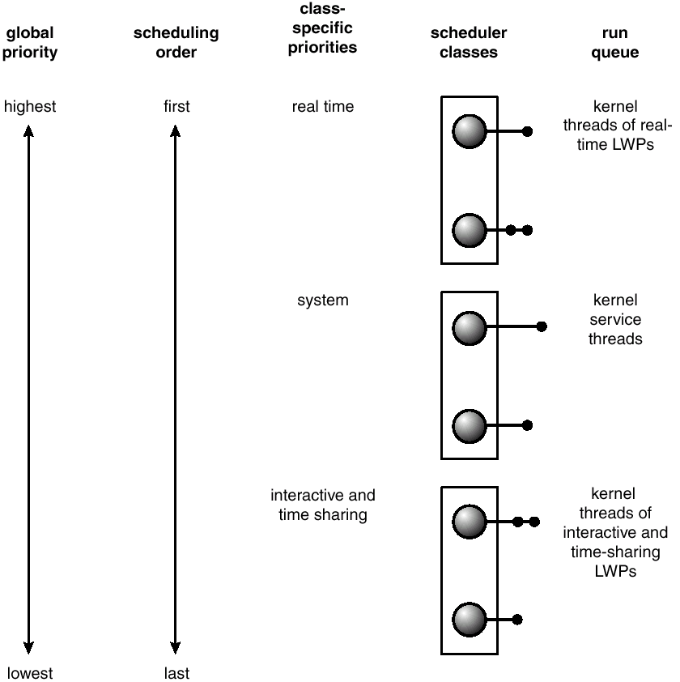
Solaris 2 Scheduling

Slide 102
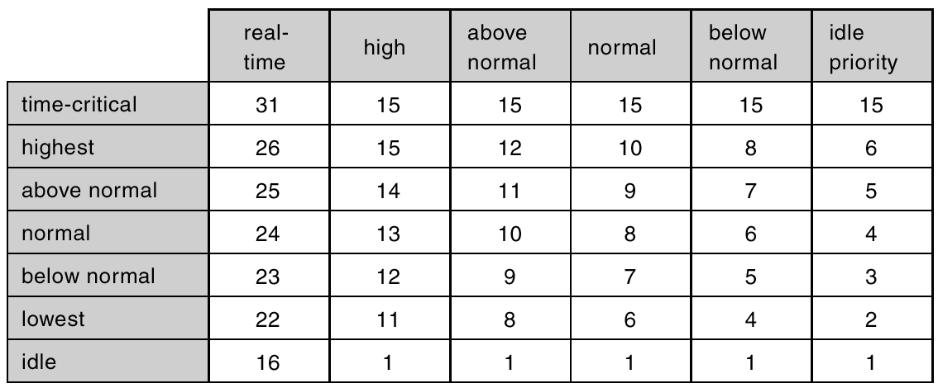
Windows 2000 Priorities

Slide 107
Operations On Process
Process Creation :
Process Termination :

Slide 108
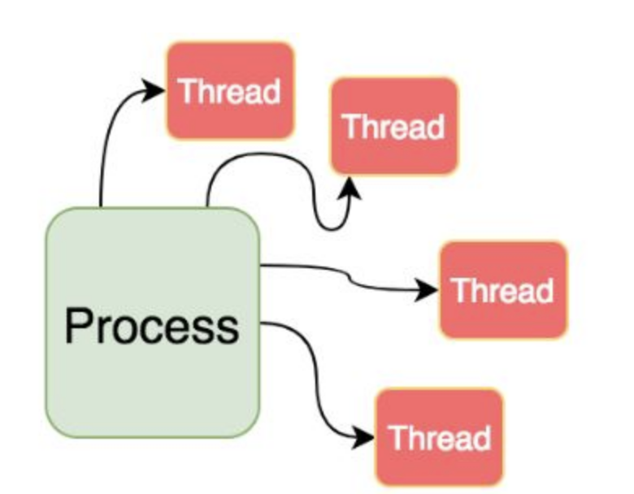
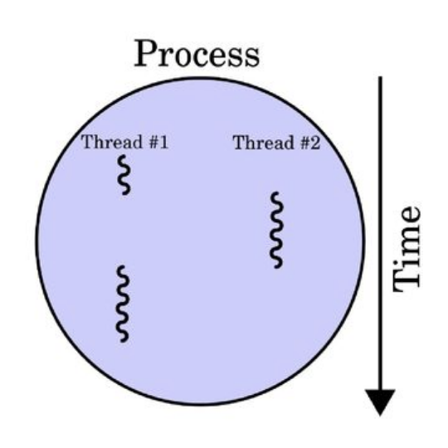
Process Vs Threads
“A thread could be said as a lightweight Process.”
Single sequential (one after another code) flow of control (or execution) within a program is called a thread.
A thread is a flow of execution inside a process.
Threads in a process share the same virtual memory address space
Context switching between threads is faster than context witching between processes.
Notes:
Several operating systems call lightweight processes threads
https://slideplayer.com/slide/13612878/

